Slide 1


WDMM 3314 Web and Multimedia Engineering SDEV 2301 Principles of Software Engineering Chapter 1 Introduction Part 2 Software engineering ethics
Dr. Nour Almadhoun Alserr
Lecture 6
Week 2
Notes:
Overcome Challenges

Slide 2

Objectives
Understand ethical and professional issues that are important for software engineers.
https://www.mtdtraining.com/blog/the-four-principles-of-ethical-management.htm

Slide 3

Software Engineering Ethics
Software engineering involves wider responsibilities than simply the application of technical skills.
Software engineers must behave in an honest and ethically responsible way if they are to be respected as professionals.
Ethical behavior is more than simply upholding the law but involves following a set of principles that are morally correct (Professional Responsibility).
Notes:
السلوك الأخلاقي هو أكثر من مجرد احترام القانون ولكنه يتضمن اتباع مجموعة من المبادئ الصحيحة أخلاقيا (المسؤولية المهنية).

Slide 4

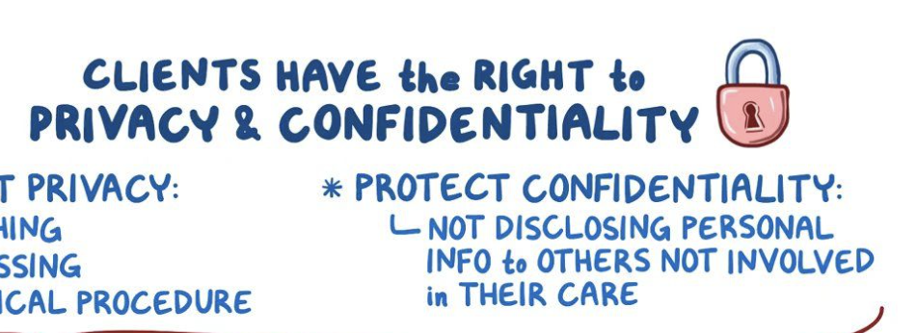

Principles of Professional Responsibility
Confidentiality:
Engineers should normally respect the confidentiality of their employers or clients regardless of whether or not a formal confidentiality agreement has been signed.
https://www.dreamstime.com/confidentiality-agreement-man-hold-information-consent-pen-hand-signing-papers-clipboard-documents-hands-men-image112434265

Slide 5
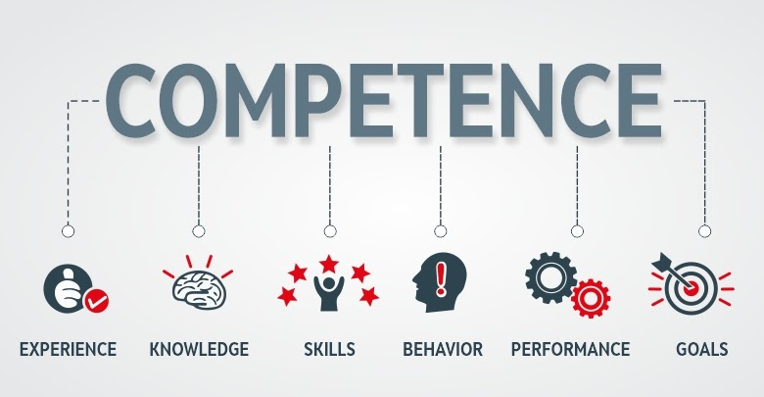
Issues of Professional Responsibility
Competence:
Engineers should not misrepresent their level of competence. They should not knowingly accept work which is outside their competence.
https://www.trainerslibrary.org/competence-hunting/
Notes:
تحريف مستوى كفاءتهم. misrepresent their level of competence
The term ‘competences’ refers to a system of values, attitudes and beliefs, and skills and knowledge that can be applied in practice to manage various complex situations and tasks successfully.

Slide 6



Issues of Professional Responsibility
Intellectual property rights:
Engineers should be aware of local laws governing the use of intellectual property such as patents and copyright.
They should be careful to ensure that the intellectual property of employers and clients is protected.
https://www.uschamber.com/co/start/startup/how-to-file-a-patent
https://portswigger.net/daily-swig/uk-firm-accused-of-bullying-small-businesses-with-csp-patent-infringement-letters-backtracks

Slide 7


Issues of Professional Responsibility
Computer misuse:
Engineers should not use their technical skills to misuse other people’s computers.
Trivial
Extremely serious
https://www.colourbox.com/image/businessman-playing-computer-games-at-work-office-image-25724067
https://uniserveit.com/blog/how-computer-virus-attacks
Notes:
Computer misuse ranges from relatively trivial (game playing on an employer’s machine, say) to extremely serious (dissemination of viruses).

Slide 8


ACM/IEEE Code of Ethics
The professional societies (notably ACM, the IEEE) in the US have cooperated to produce a code of ethical practice.
Members of these organizations sign up to the code of practice when they join.
The Code contains eight Principles related to the behavior of and decisions made by professional software engineers, including practitioners, educators, managers, supervisors and policy makers, as well as trainees and students of the profession.
Notes:
This code exists in both a short form, shown in Figure 1.3, and a longer form (Gotterbarn, Miller, and Rogerson
1999) that adds detail and substance to the shorter version. The rationale behind this
code is summarized in the first two paragraphs of the longer form:
ACM: Association for Computing Machinery

Slide 9
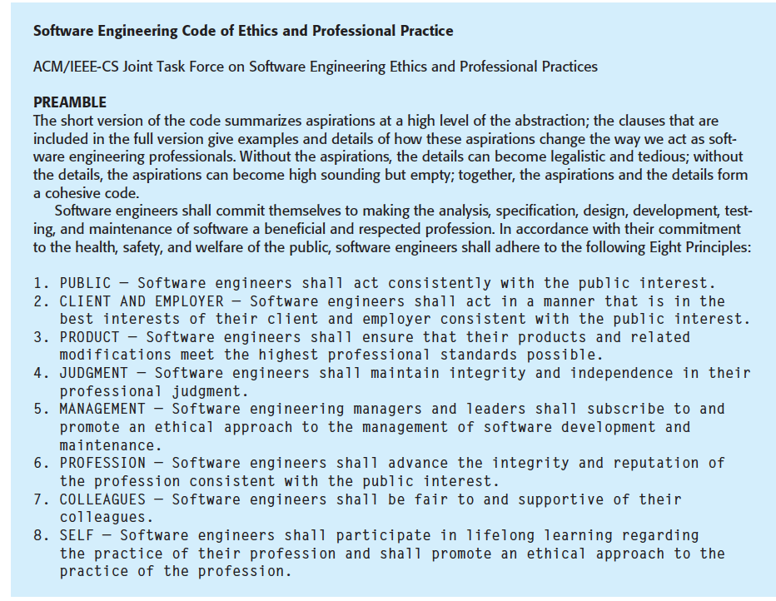
ACM/IEEE Code of Ethics
Ian Somerville, “Software Engineering”, 10th edition, Pearson, 2016.

Slide 10
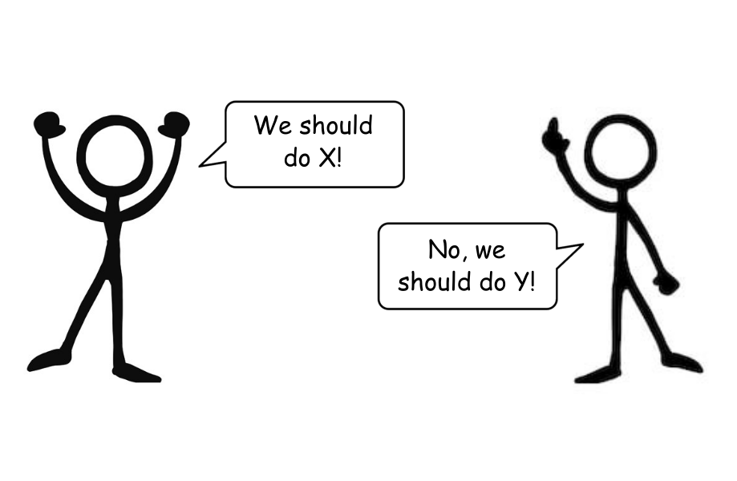

Ethical Dilemma
Disagreement in principle with the policies of senior management.
Is it best to argue a case for your position from within the organization or to resign in principle?
When do you reveal the software problems to management?
https://polarity.coach/10-tips-for-navigating-deep-disagreement/
Notes:
If you discuss these while they are just a suspicion, you may be overreacting to a situation; if you leave it too long, it may be impossible to resolve the difficulties.
fortunately, in most cases they are either relatively minor or can be resolved without too much difficulty. Where they cannot be resolved, the engineer is faced with, perhaps, another problem. The principled action may be to resign from their job

Slide 11



Ethical Dilemma
Your employer acts in an unethical way and releases a safety-critical system without finishing the testing of the system.
Notes:
A difficult situation for professional engineers arises when their employer acts in
an unethical way. Say a company is responsible for developing a safety-critical
system and, because of time pressure, falsifies the safety validation records. Is the
engineer’s responsibility to maintain confidentiality or to alert the customer or
publicize, in some way, that the delivered system may be unsafe?

Slide 12



Ethical Dilemma
Participation in the development of military, weapons, and nuclear systems.
It is important that both employers and employees should make their views known to each other in advance.
If an employee is taken on and makes clear that he or she does not wish to work on such systems, employers should not exert pressure to do so at some later date.

Slide 13

Do you have
any QUESTIONS??
Notes:
Do you have any Questions?

